Slide 1
shark tank project
File created on: 6/26/2025 12:18:20 PM

Slide 2
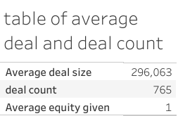

Slide 3


Slide 4
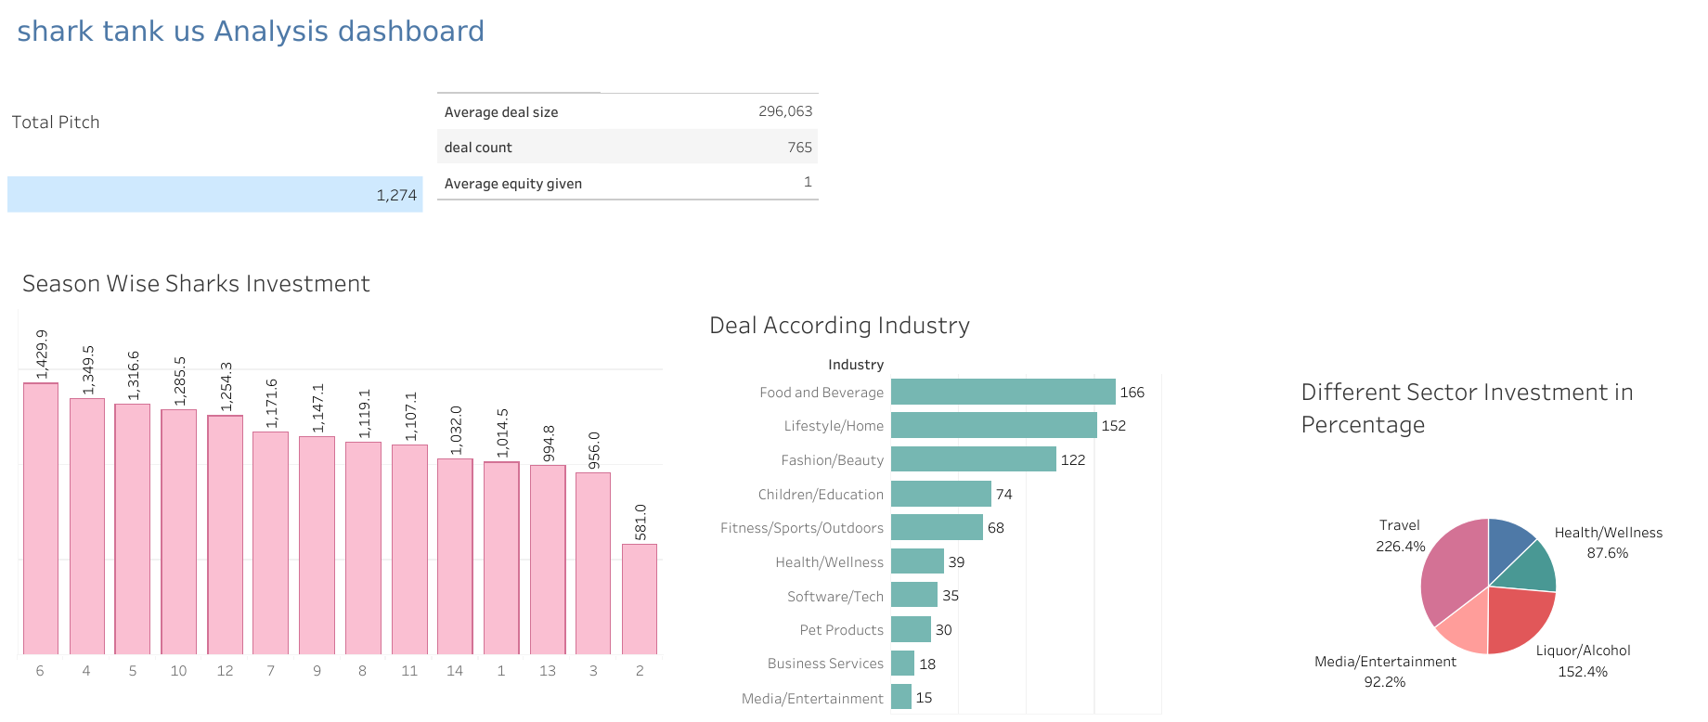

Slide 5


Slide 6
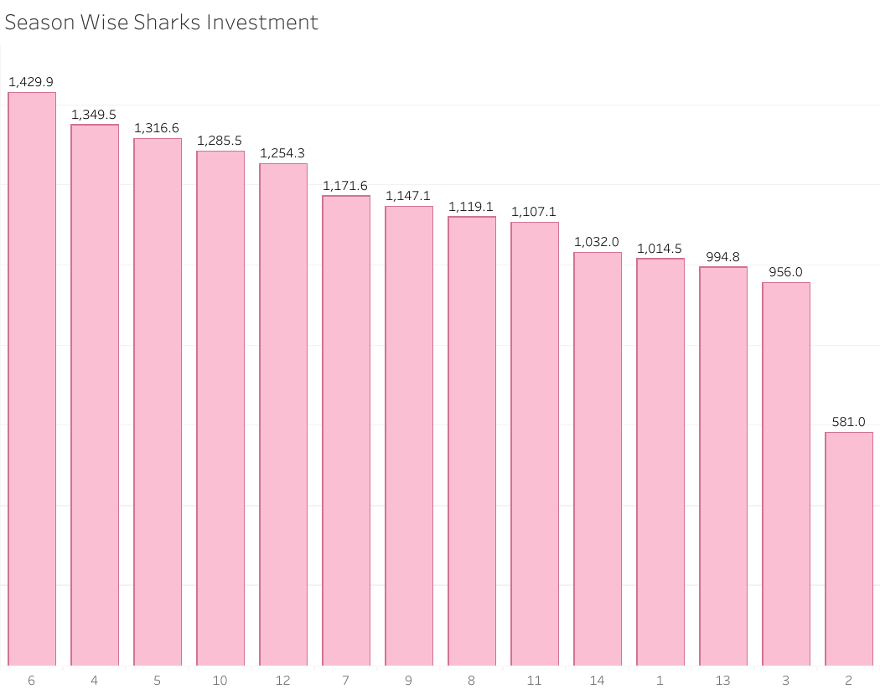

Slide 7
